Slide 1
Mapping functionality scripts
to documents by multi class
classification
Prince kumar

Slide 2
CONTENT
1
2
3
Preprocessing
Introduction
Extraction
4
Classifier
documents
text from documents
stop words remove
linear svc
scripts
text from scripts
lemmatize
logistic regression
tf-idf
random forest
countvectorizer

Slide 3
Introduction
We have been provided with corpus of functionality scripts and documents.
Our approach is to understand documents text and script data and try to find out most relevent features to map them together.
Documents text are in html format and functionality scripts are in key value pair (json) format.
Preprocessing of raw text and then convert the text into vectors .
Multi label classification using machine learning algorithms.

Slide 4
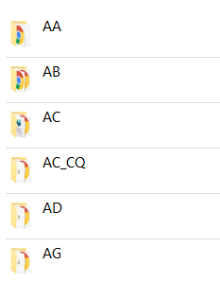
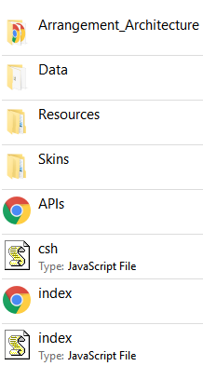
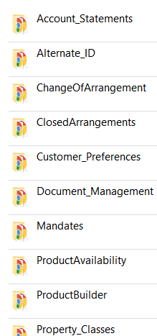
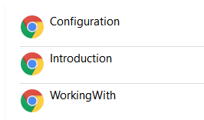
Extraction of text from document step by step
TLlab,nCb fmv mckjhBHBabelsITLE
As we can see ,this process of extraction of text is multi level .
We chose the folders name as labels for the classsification of our scripts because html text are present in its subfolders .
TEXT
TEXT
TEXT:XXXXXX,TEXT:XXXXXX,
→
→
→
TITLE
TITLE
TITLE
TEXT
TEXT
TEXT
TEXTAdkjqwbfkb:XXXXXX,TEXT:XXXXXX,
TEXT:XXXXXX,TEXT:XXXXXX,
TEXT:XXXXXX,TEXT:XXXXXX,

Slide 5
Mapping Implementation
Our training data obtained from html text from the documents.
Our testing data obtained from the functionality scripts.
Preprocessing is one of the main steps,from the documents,the text being converted from html to plain text using ”Beautifulsoup” and the functionality scripts are in key value pair(json format).
Prediction of labels for test data obtained from the functionlity script.

Slide 6
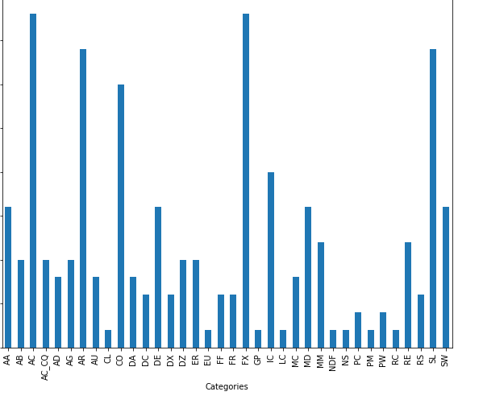
Distribution of dataframe
“Categories” column consist the labels of document's text

Slide 7
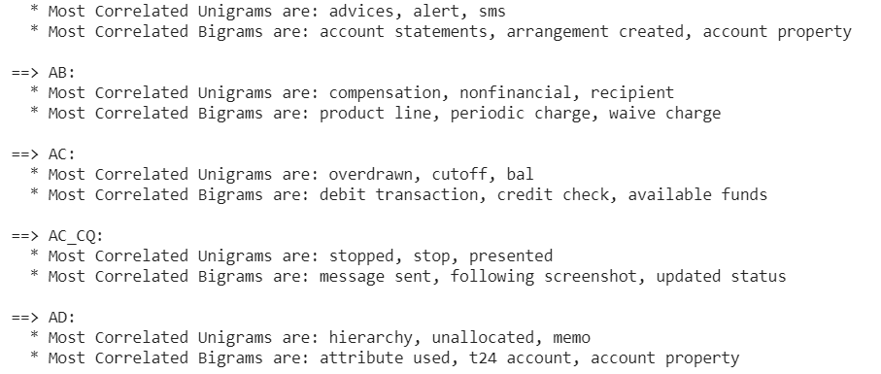
Catching context using n-gram
We tried to analyse 2-grams(or bigram) in our dataframe to find out most correlated words.
You can think of an N-gram as the sequence of N words, by that notion, a 2-gram (or bigram) is a two-word sequence of words .
unigrams and bigrams in our datframe in each labels

Slide 8
TF-IDF = Term Frequency (TF) * Inverse Document Frequency (IDF)
Terminology
t — term (word)
d — document (set of words)
N — count of corpus
corpus — the total document set
Text-processing:- we have to convert the text to vectorize it after lowering and removing stop words . TF_IDF will give us the most important words in our text
The tf-idf model is the model of tf and idf. TF:- term frequency ,it tells us the frequency of words in a given document IDF:- Inverse-Document-Frequency,it tells us ,how rare or commom a word in the document
text
Preprocessing
Tf-idf
Vectorize

Slide 9
CountVectorizer
It provides a simple way to both tokenize a collection of text documents and build a vocabulary of known words, but also to encode new documents using that vocabulary.
You can use it as follows:
Create an instance of the CountVectorizer class.
Call the fit() function in order to learn a vocabulary from one or more documents.
Call the transform() function on one or more documents as needed to encode each as a vector.
An encoded vector is returned with a length of the entire vocabulary and an integer count for the number of times each word appeared in the document.

Slide 10
One vs Rest
This strategy, also known as one-vs-all, is implemented in OneVsRestClassifier.
The strategy consists in fitting one classifier per class.
For each classifier, the class is fitted against all the other classes.
Advantage of this approach is its interpretability. Since each class is represented by one and only one classifier, it is possible to gain knowledge about the class by inspecting its corresponding classifier.
This is the most commonly used strategy and is a fair default choice. So we shall go by this method

Slide 11
Classifiers
Logistic Regression
Randomforest
Linear SVC

Slide 12
Linear SVC
The objective of a Linear SVC (Support Vector Classifier) is to fit to the data you provide, returning a "best fit" hyperplane that divides, or categorizes, your data.
From there, after getting the hyperplane, you can then feed some features to your classifier to see what the "predicted" class is.
This makes this specific algorithm rather suitable for our use.

Slide 13
Logistic Classifier
A contradiction appears when we declare a classifier whose name contains the term ‘Regression’ is being used for classification, but this is why Logistic Regression is magical: using a linear regression equation to produce discrete binary outputs . And yes, it is also categorized in ‘Discriminative Models’ subgroups of ML methods like Support Vector Machines and Perceptron where all use linear equations as a building block and attempts to maximize the quality of output on a training set.

Slide 14
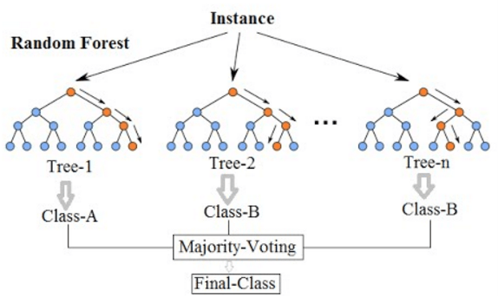
Random Forest Classifier
It is an ensemble tree-based learning algorithm.
The Random Forest Classifier is a set of decision trees from randomly selected subset of training set.
It aggregates the votes from different decision trees to decide the final class of the test object.

Slide 15
X_train, X_test, y_train, y_test,indices_train,indices_test = train_test_split(features,
labels,
df.index, test_size=0.25,
random_state=1)
model = OneVsRestClassifier(LinearSVC())
model.fit(X_train, y_train)
y_pred = model.predict(X_test)
print('accuracy %s' % accuracy_score(y_test, y_pred))
Model prediction on test script
X_train, X_test, y_train, y_test,indices_train,indices_test = train_test_split(features, labels,df.index, test_size=0.25, random_state=1)
model = OneVsRestClassifier(LinearSVC())
model.fit(X_train, y_train)
y_pred = model.predict(X_test)
print('accuracy %s' % accuracy_score(y_test, y_pred))
accuracy: 0.7358490566037735
label : ['CO']

Slide 16
Conclusion
Using various algorithms like linear SVC,
randomforest classifier.
we trained our model on documents text.
Testing data is the text from Script
Our classifier predict the labels .
Thus using this multi class classification model we can map our scripts to documents.

Slide 17
THANK YOU

